Slide 1
GIFT SHOP
REPORT WEB TECHNOLOGY AND SERVICES (CT313H)
Student Information
Nguyen Duy Khang - B1910652
Tran Ba Phuong - B1908407
Semester 1, 2022-2023

Slide 2

Description of application functions
Describe project: blockchain-integrated sales website
The functions of the application
View product list by category
Choose teddy bear size change price
Add to cart
Remove from cart
Change quantity when buying
Review order history
Online payment

Slide 3
Work assignment
WORK | PERFORMER
Build source | Tran Ba Phuong
Build database | Nguyen Duy Khang
Code server (back-end) | Nguyen Duy Khang
Code ui | Both
Blockchain integration | Tran Ba Phuong

Slide 4
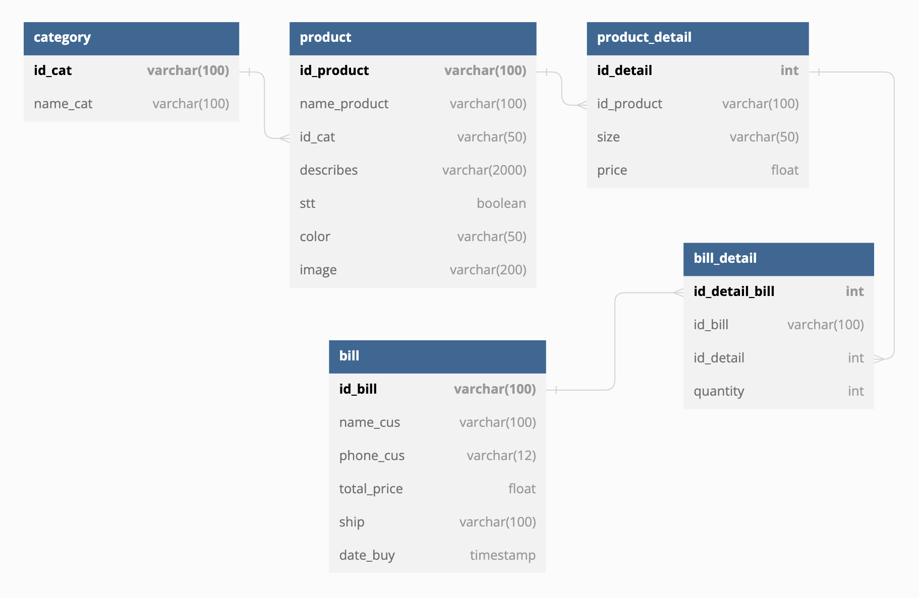
Database

Slide 5
HTTP API
Data to be sent to the server | Server data returned
category: string | product: an array of multiple attributes:
 | id_product: string name: string Id_detail: array size: array price: array describes: string status: string color: string image: string
/product/getProductByCat used to get products by type.

Slide 6
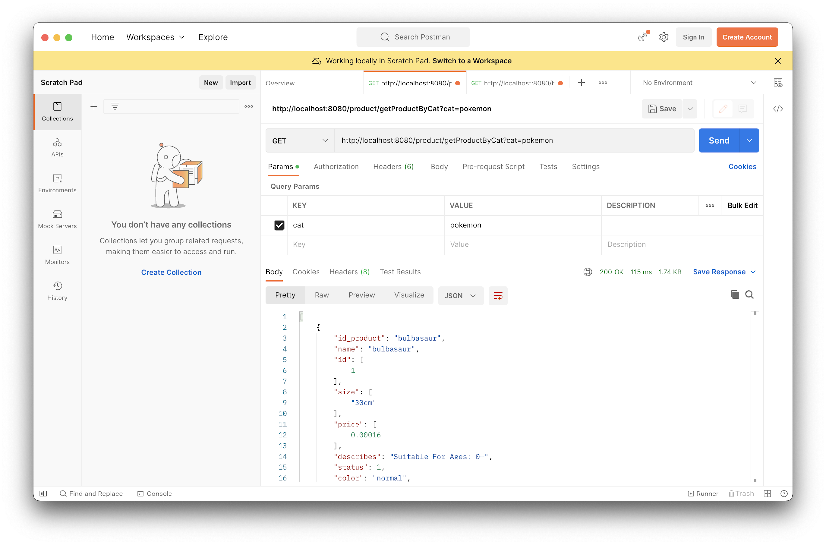
/product/getProductByCat

Slide 7
HTTP API
Data to be sent to the server | Server data returned
name: string phone: string totalPrice: number typeShip: string listProduct: an array of multiple attributes: | statusCode: 200, massage: "Success"
id_detail: string quantity: number | statusCode: 500, massage: “False"
/bill/addBill used to add a successfully paid order.

Slide 8
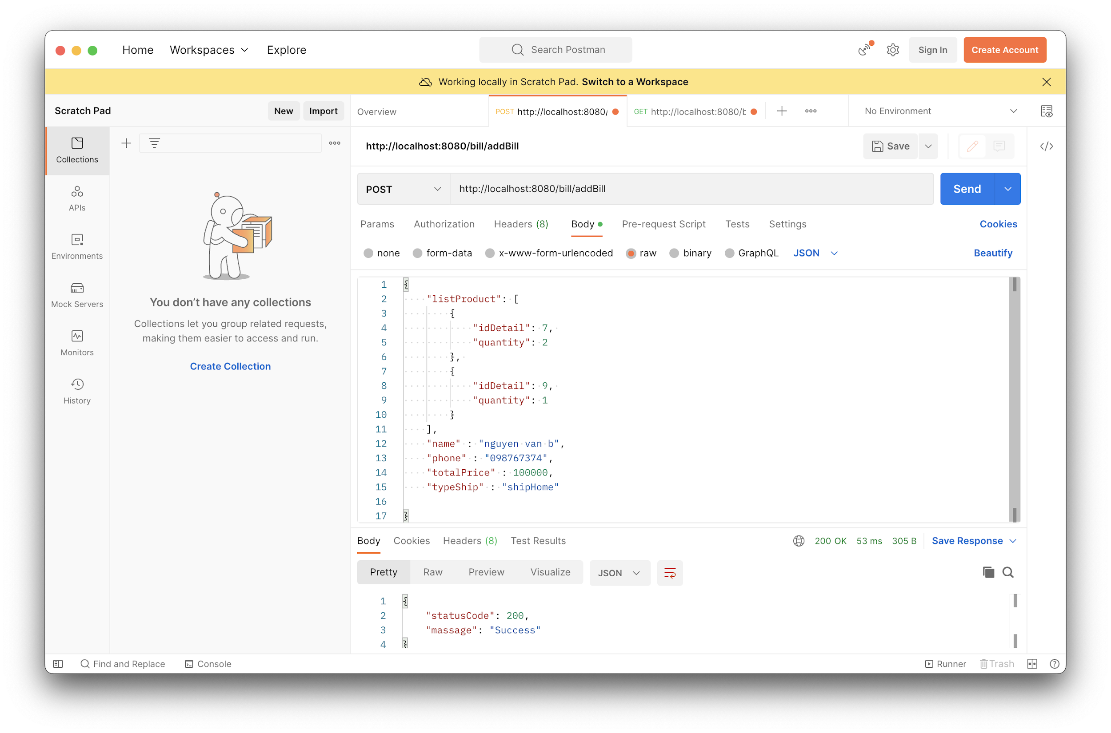
/bill/addBill

Slide 9
HTTP API
Data to be sent to the server | Server data returned
phone: string | namecus: string phone: string listOders: an array of multiple attributes:
 | Id_product: string name: string size: string quantity: number image: string date: string
/bill/getBillByPhone use to view order history.

Slide 10
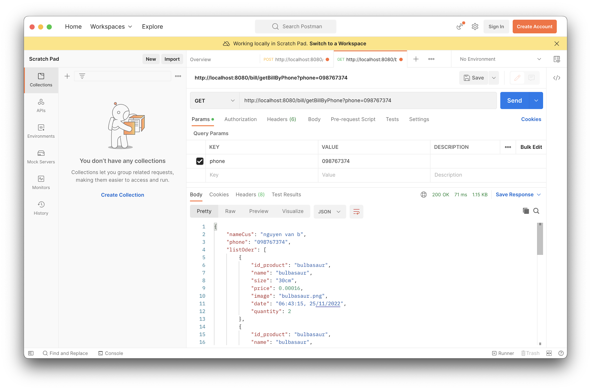
/bill/getBillByPhone

Slide 11
Libraries used
uuid(v4) used to generate a unique id that replaces the auto imcrement field in the database.
Yarn used as an alternative to the npm command.
Sweetalert2 to customize the alert message.
Ant Design Vue provides plenty of UI components to enrich our web applications.
Tailwind is a utility-first CSS framework packed with classes like flex, pt-4, text-center and rotate-90 that can be composed to build any design, directly in your markup.

Slide 12
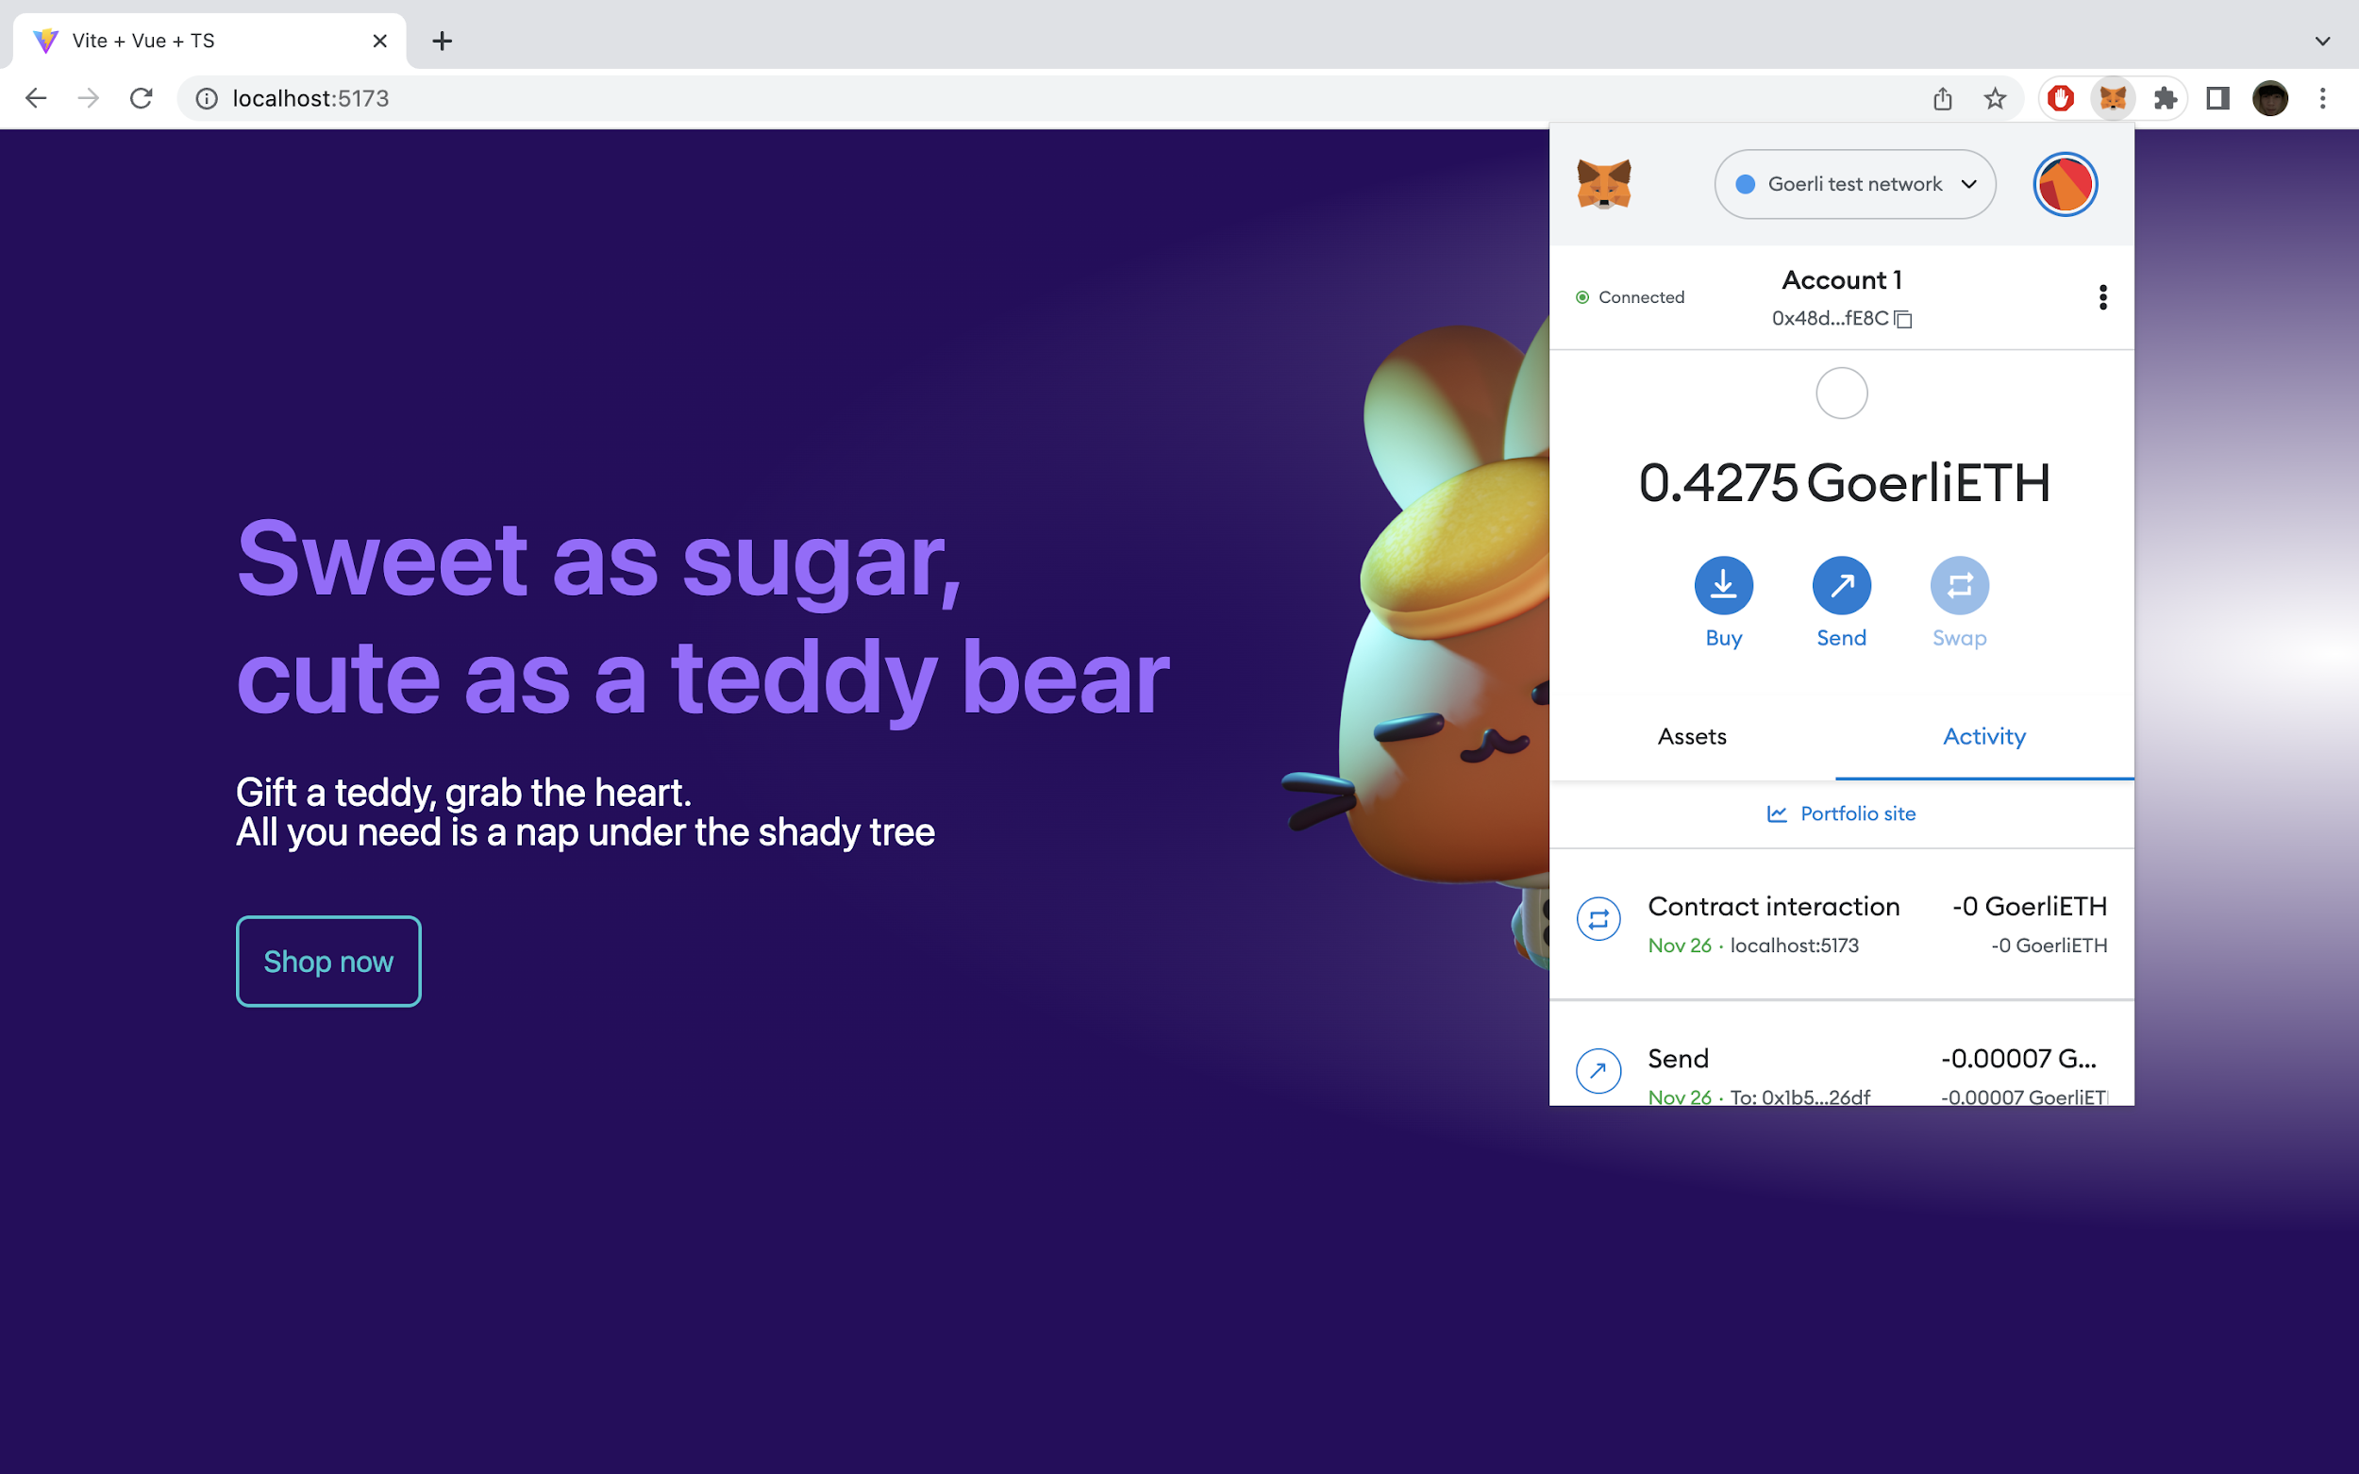
Result

Slide 13
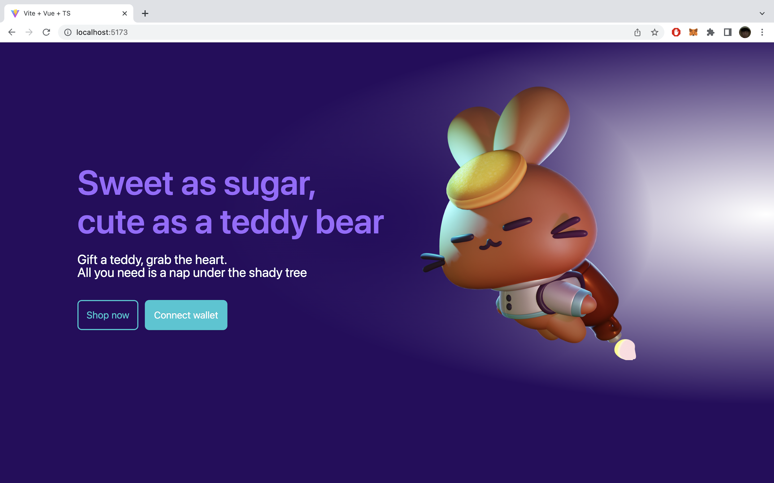
Result

Slide 14
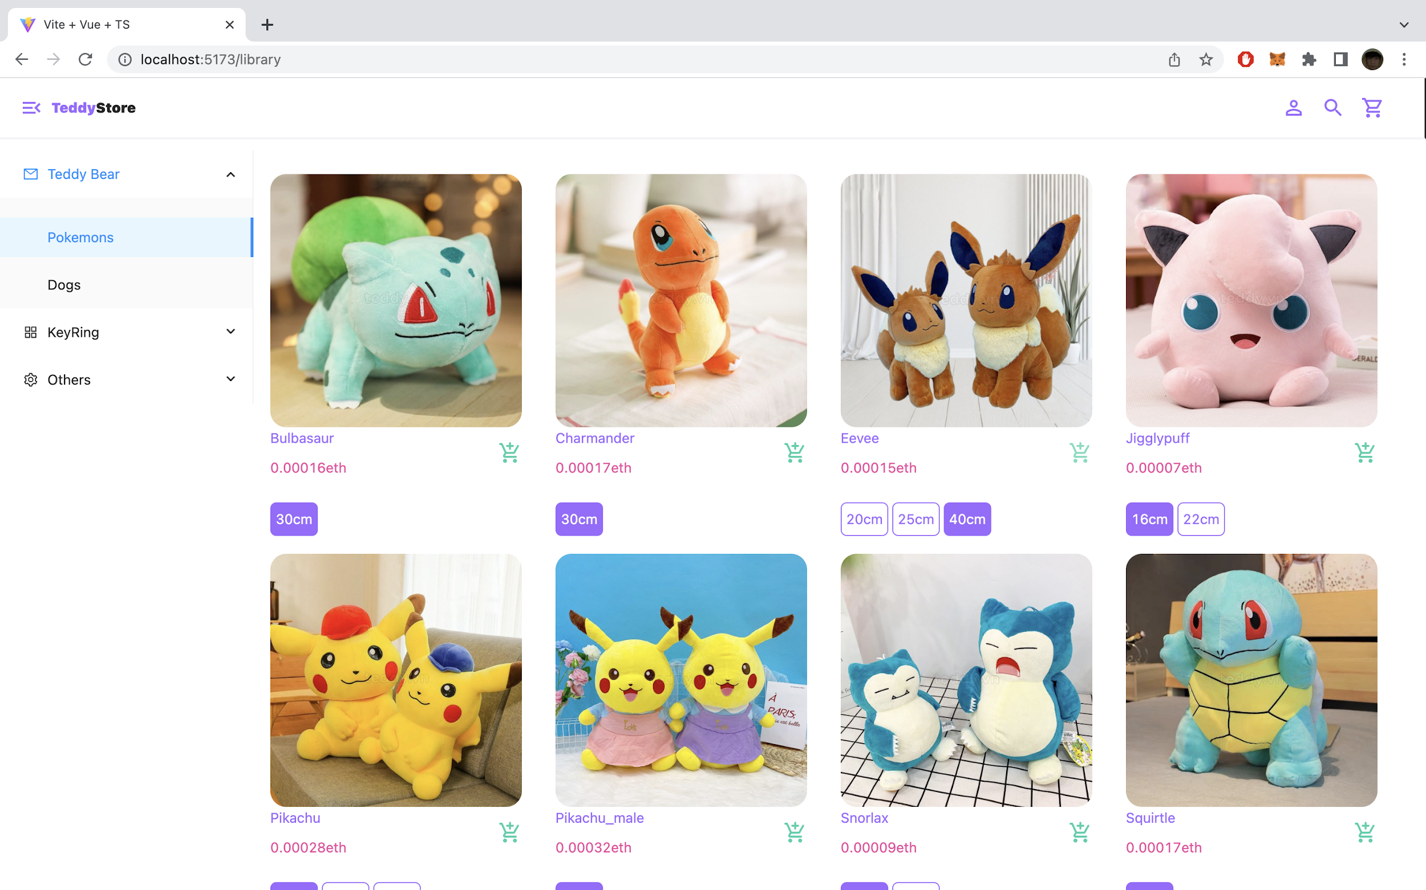
Result

Slide 15
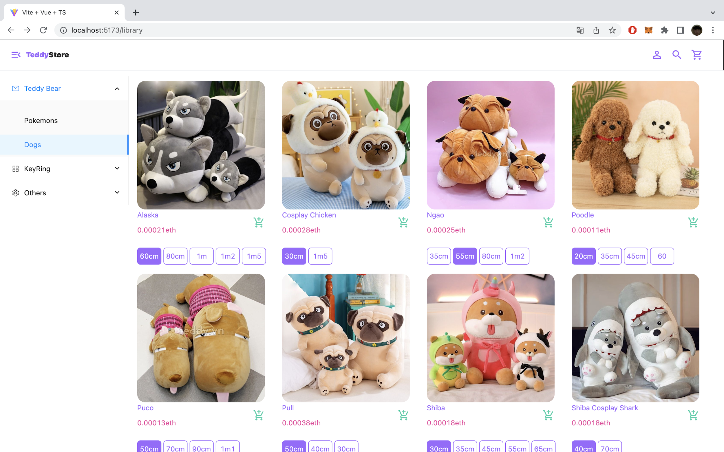
Result

Slide 16
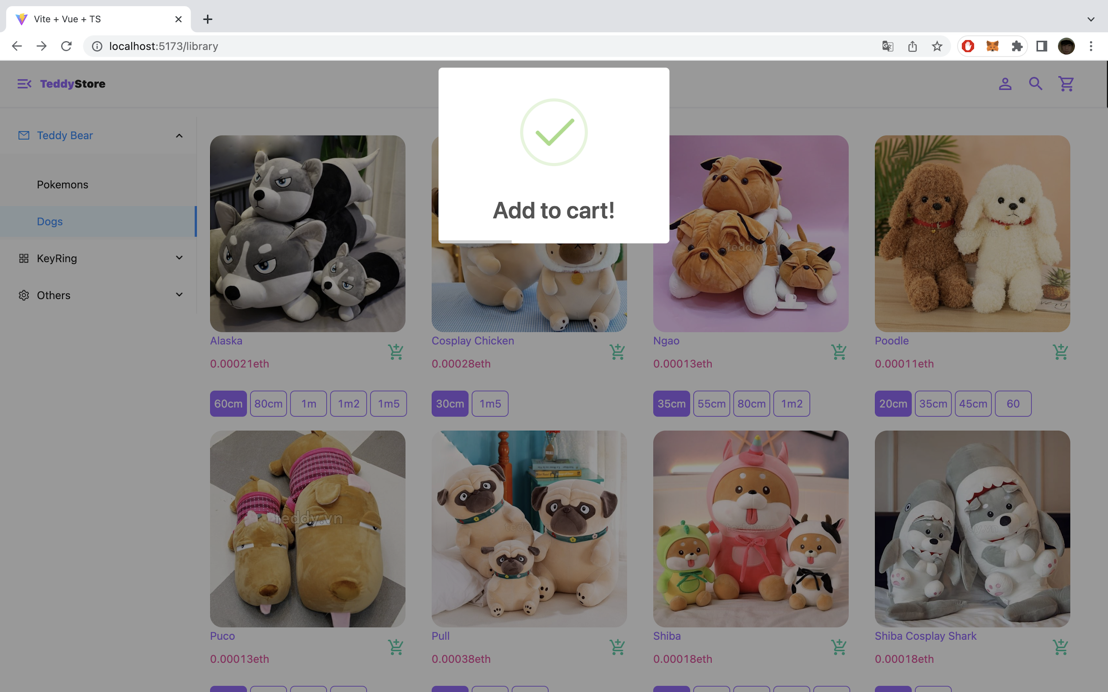
Result

Slide 17
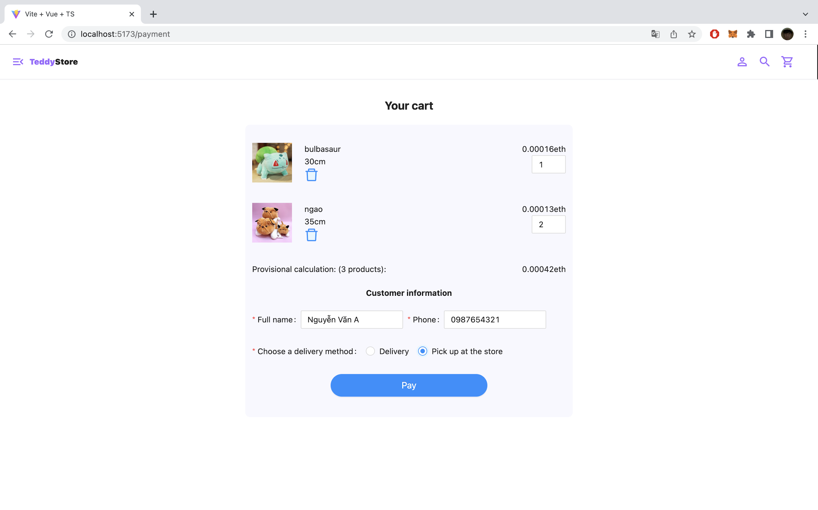
Result

Slide 18
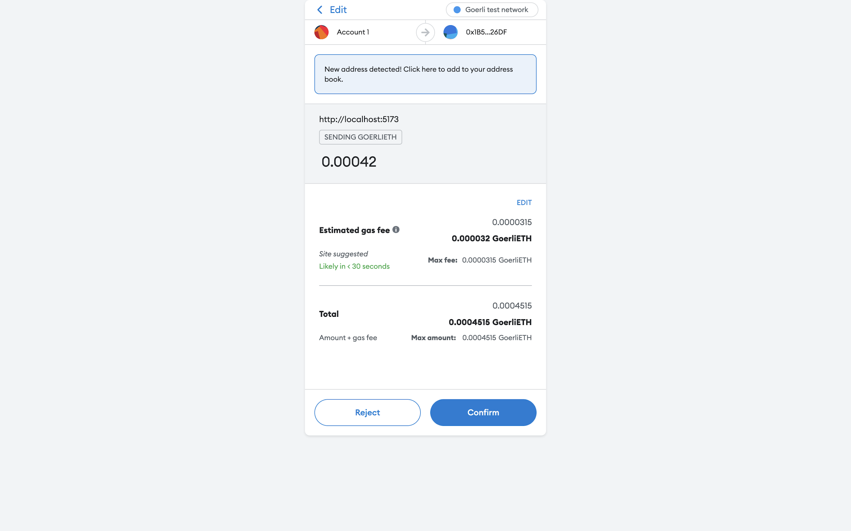
Result

Slide 19
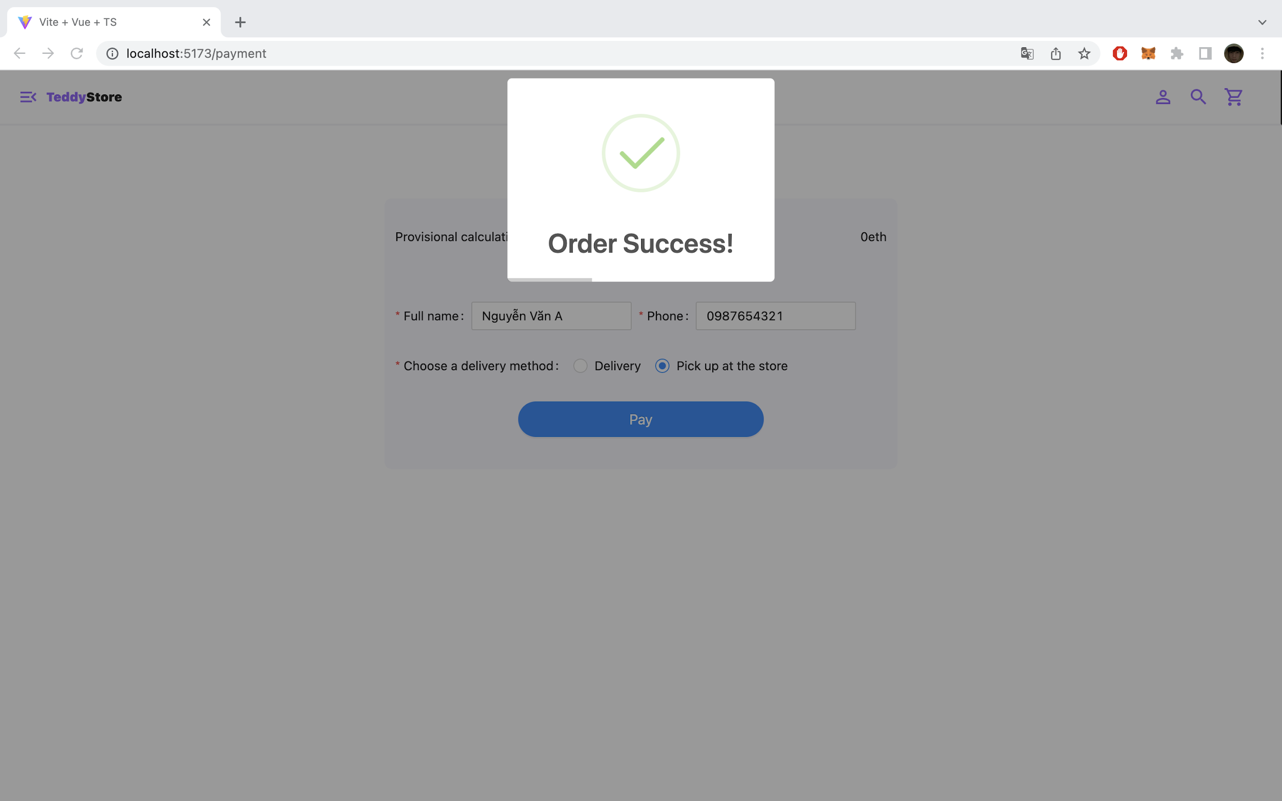
Result

Slide 20
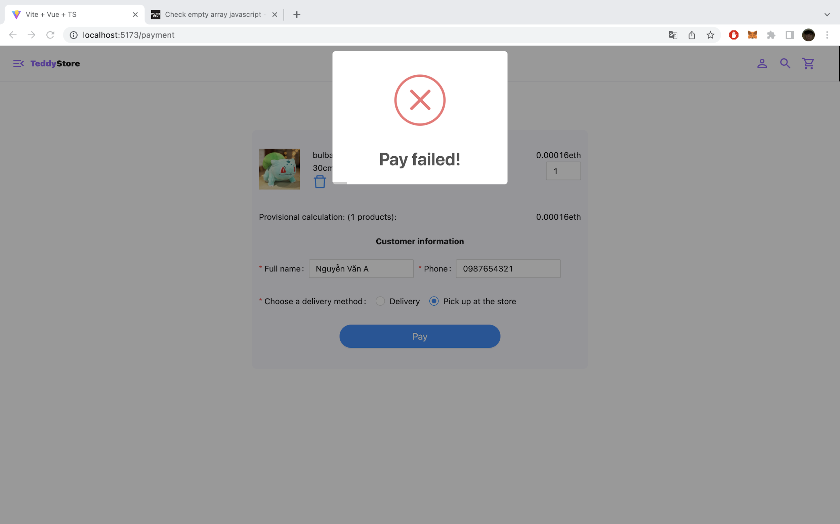
Result

Slide 21
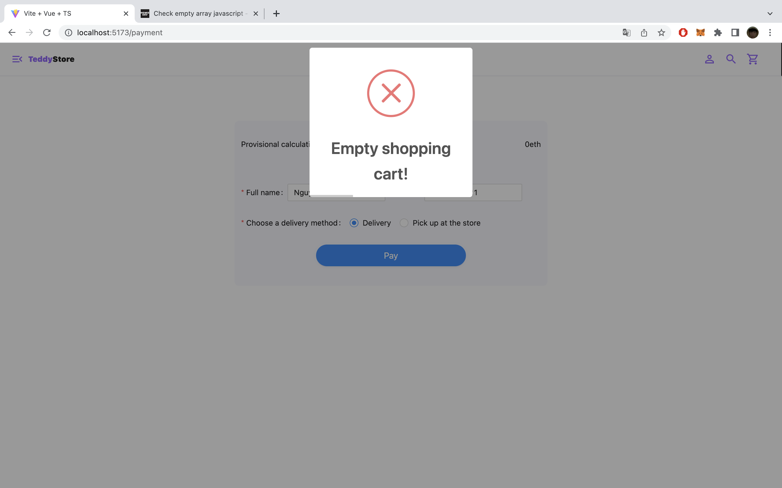
Result

Slide 22
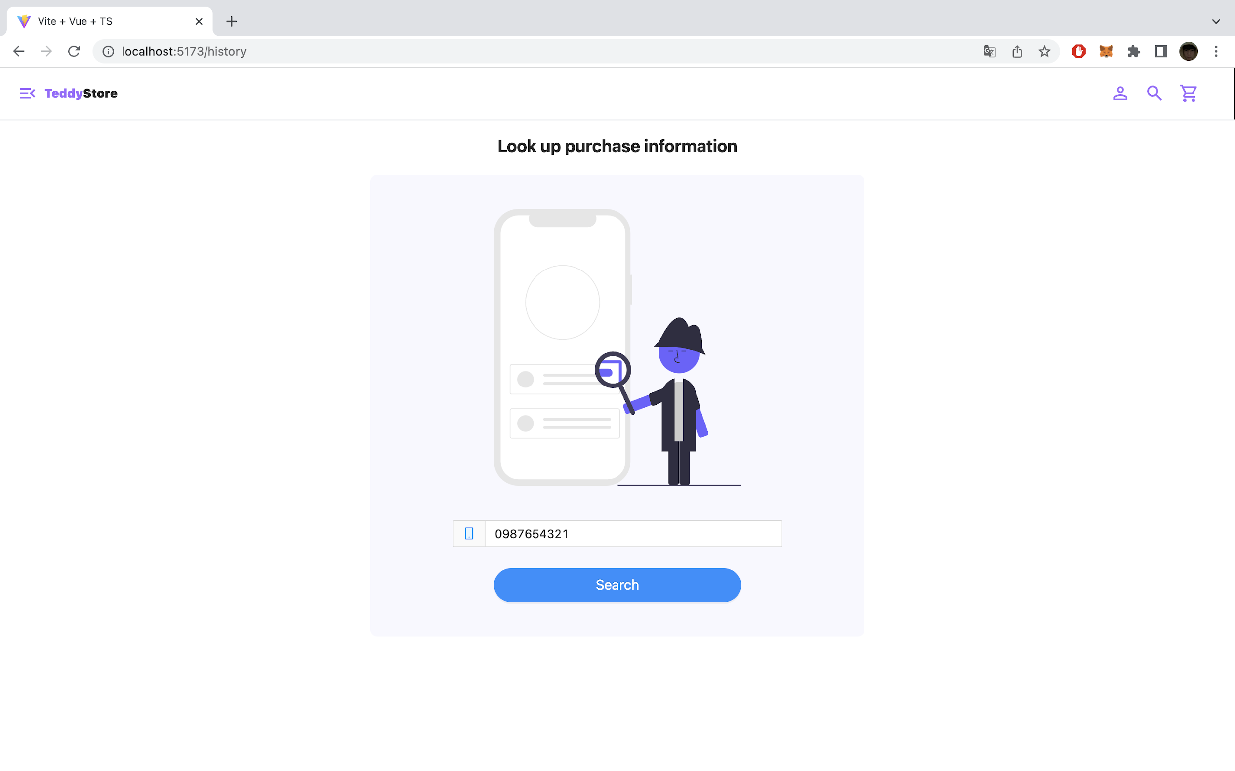
Result

Slide 23
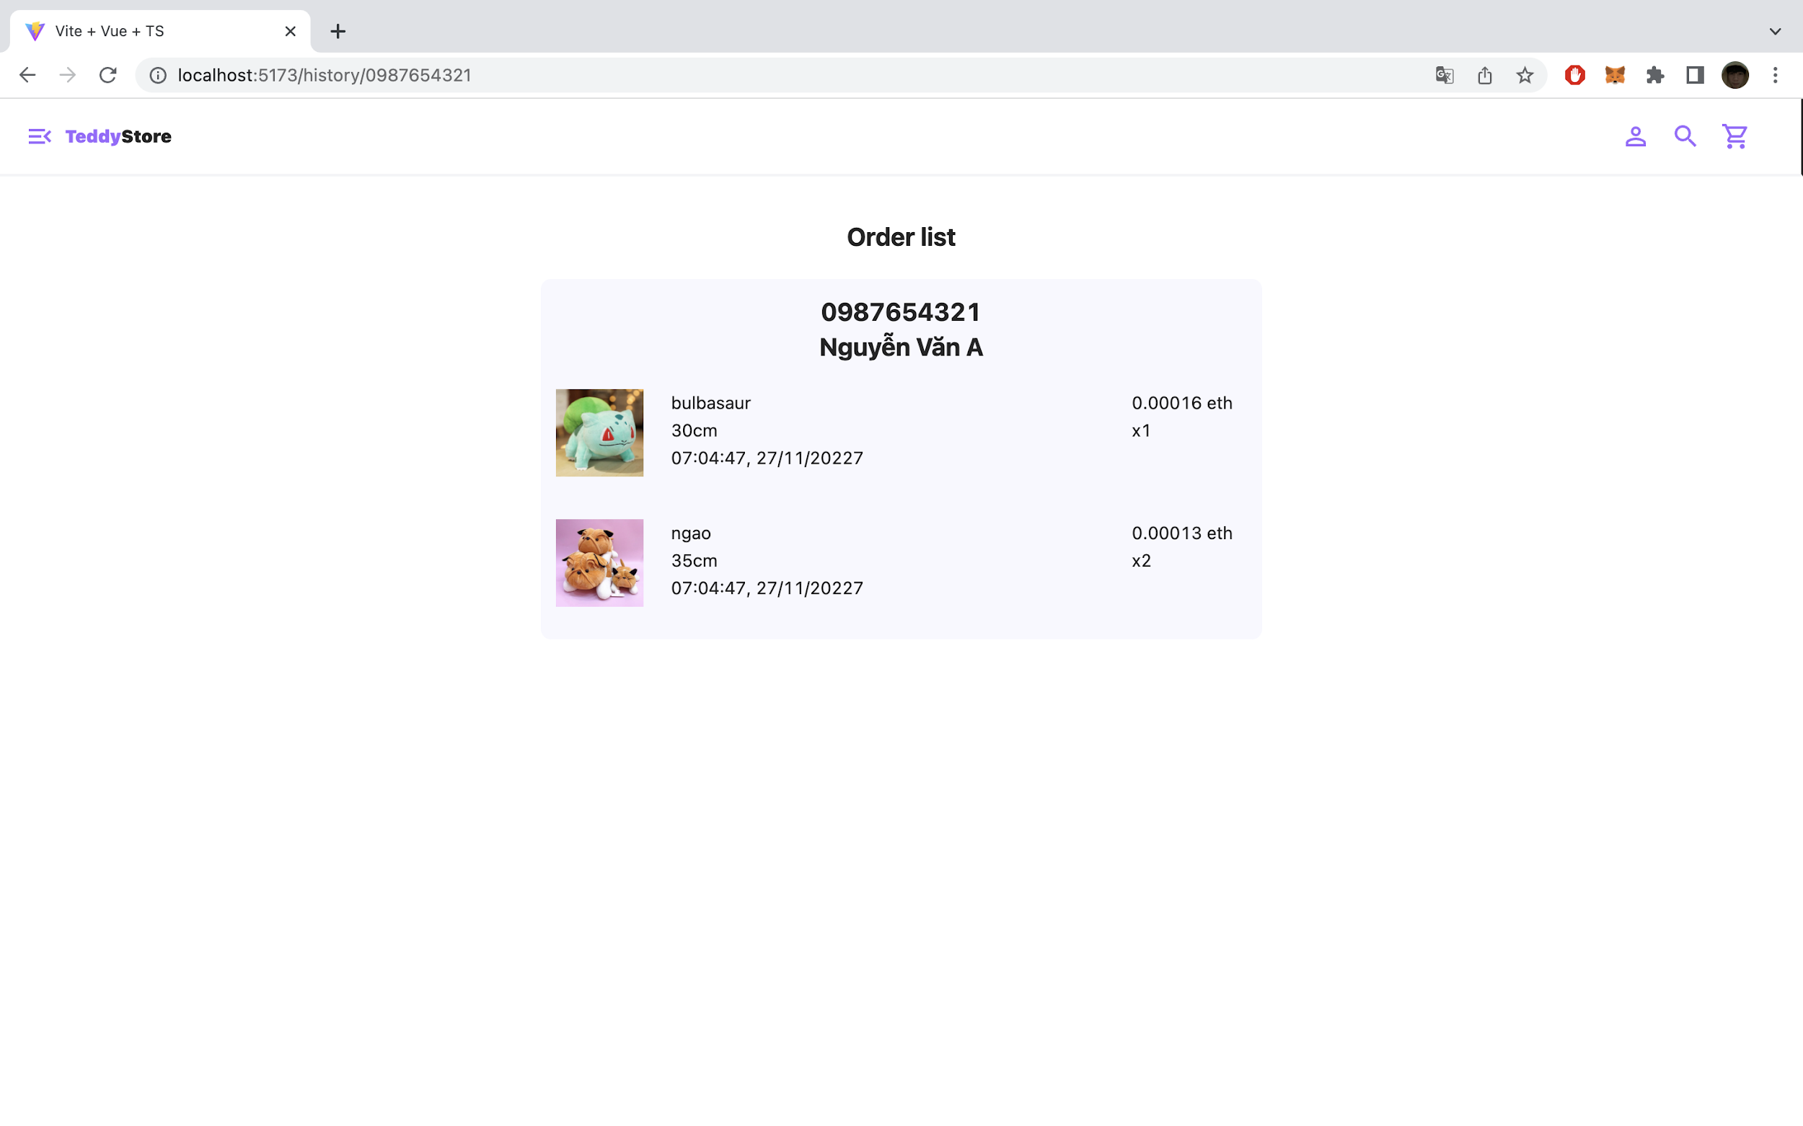
Result

Slide 24
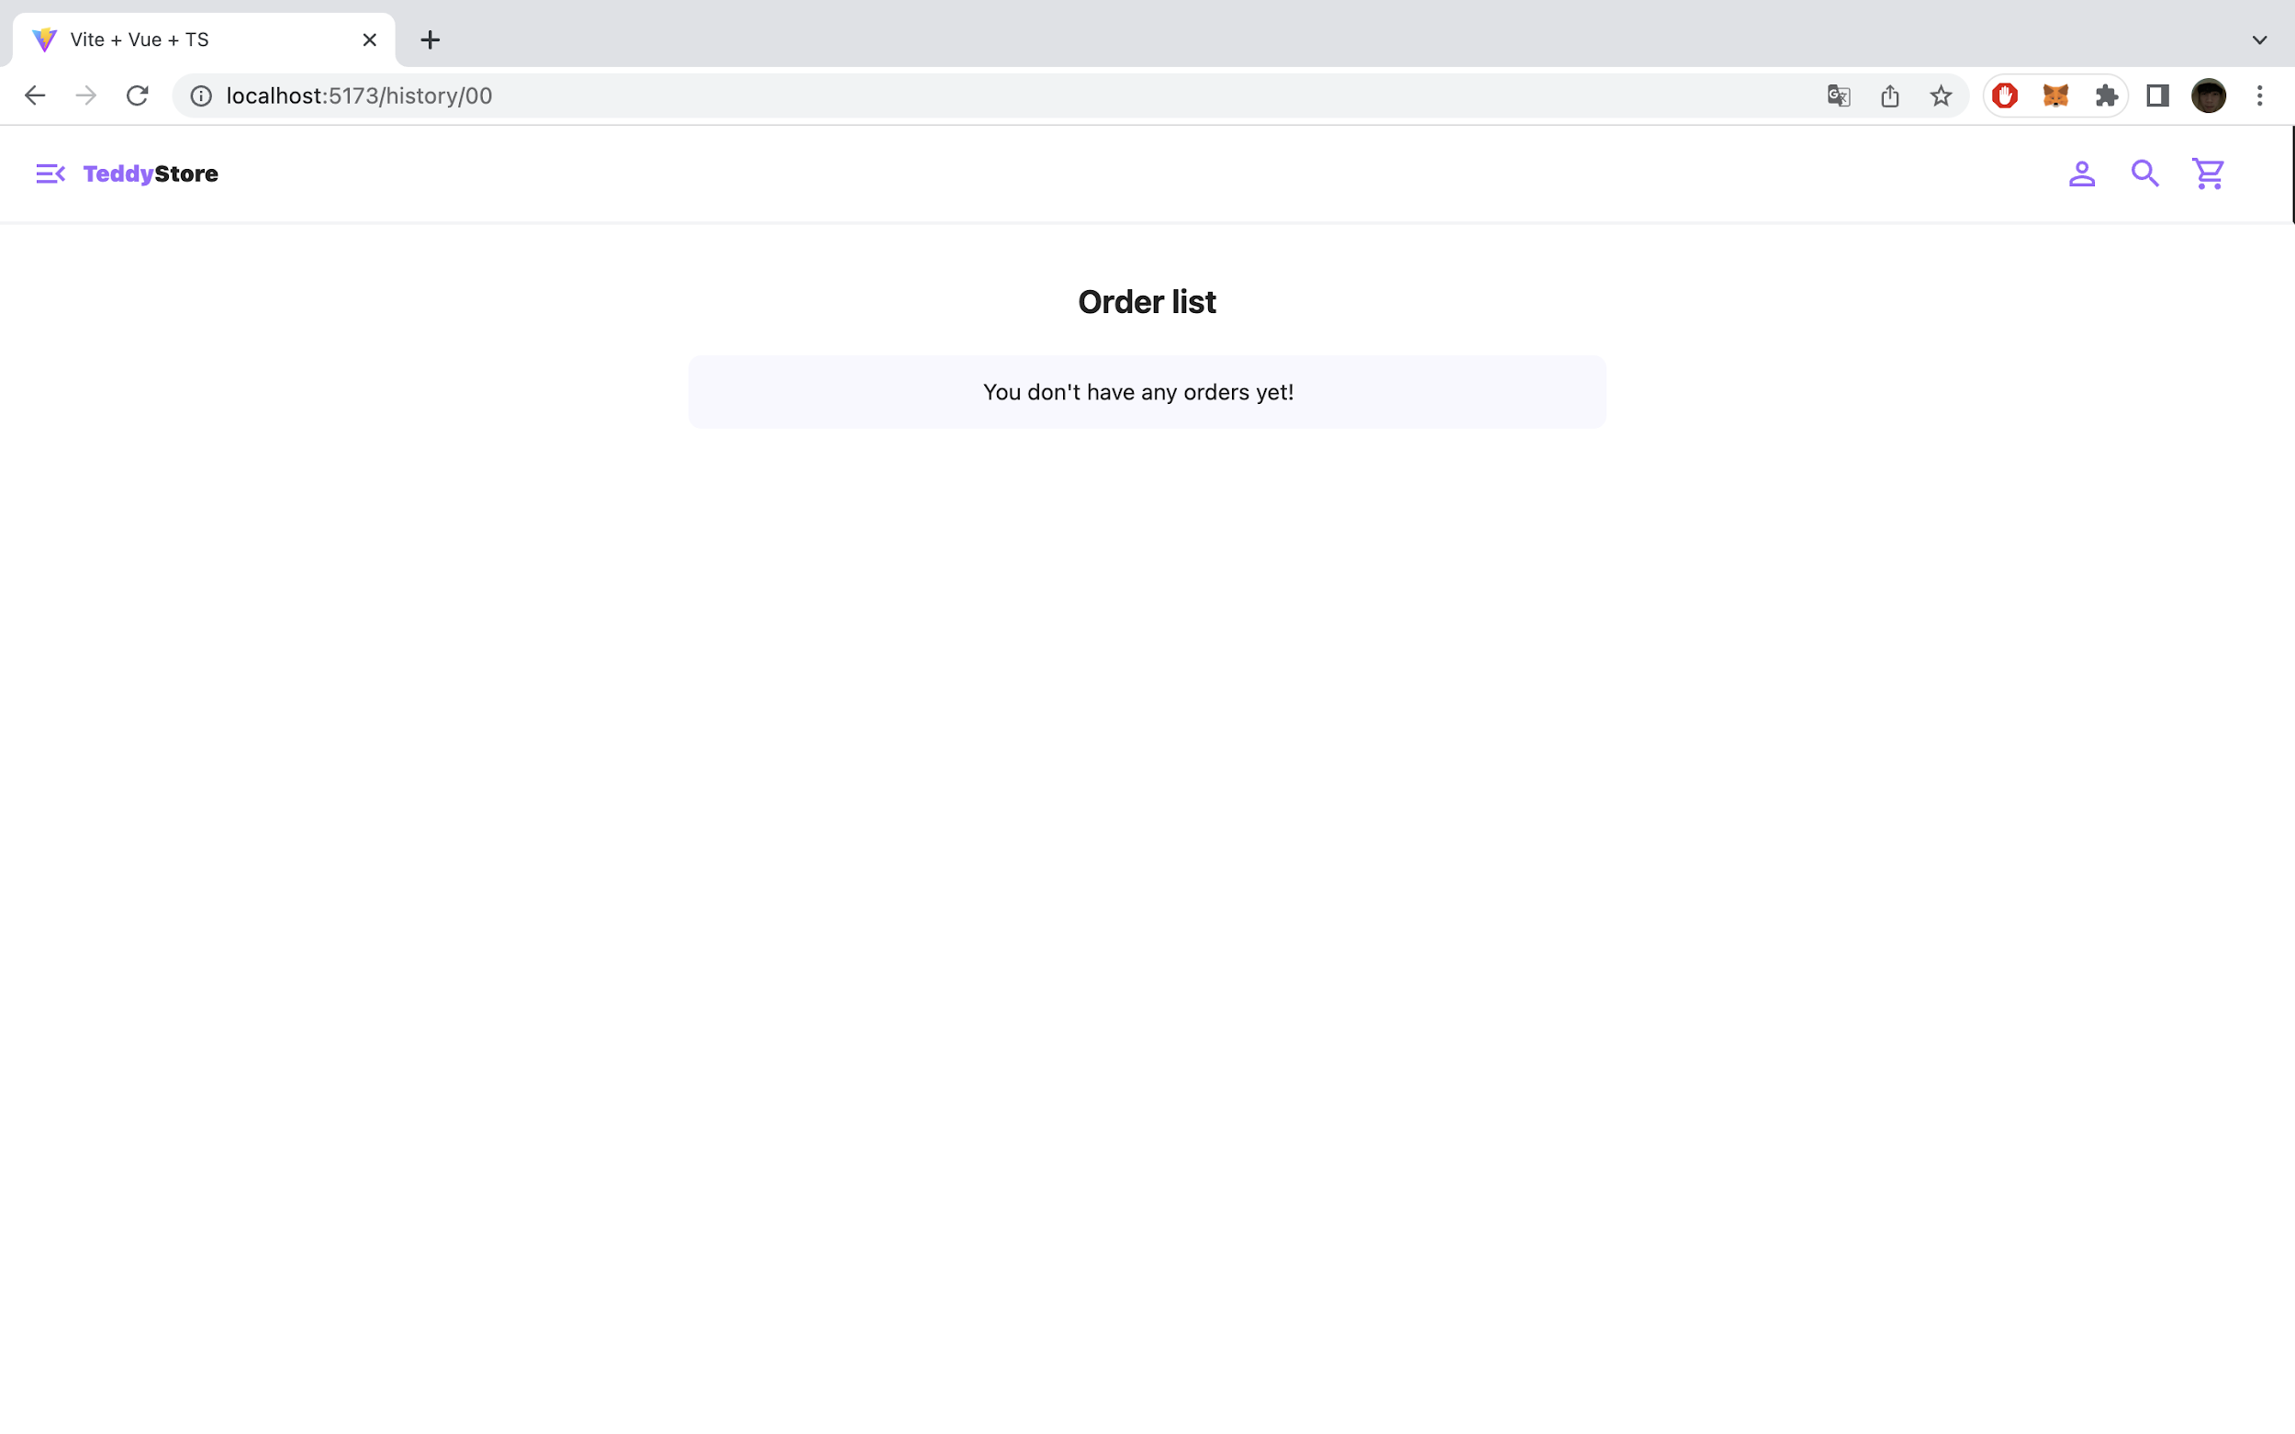
Result

Slide 25
Source code
https://github.com/ba-p/gift-shop.git

Slide 26

Thank you for listening!

